Slide 1
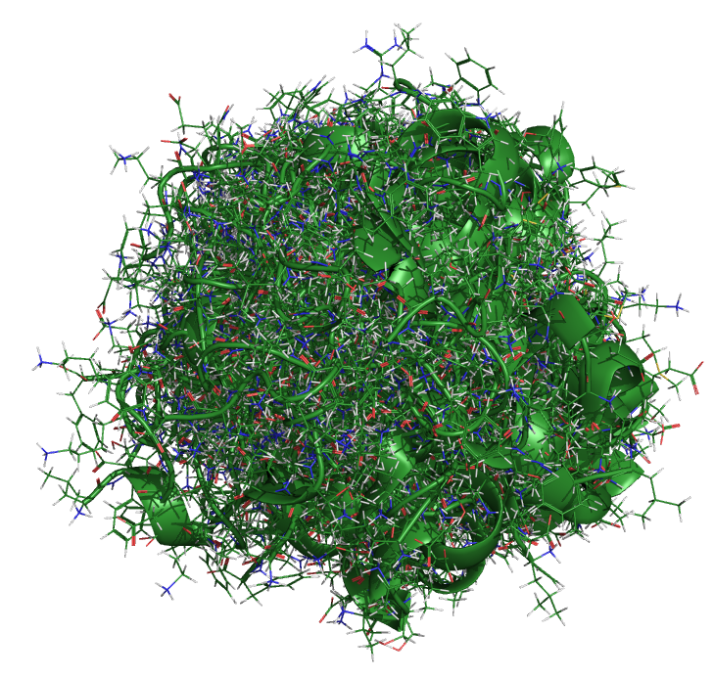
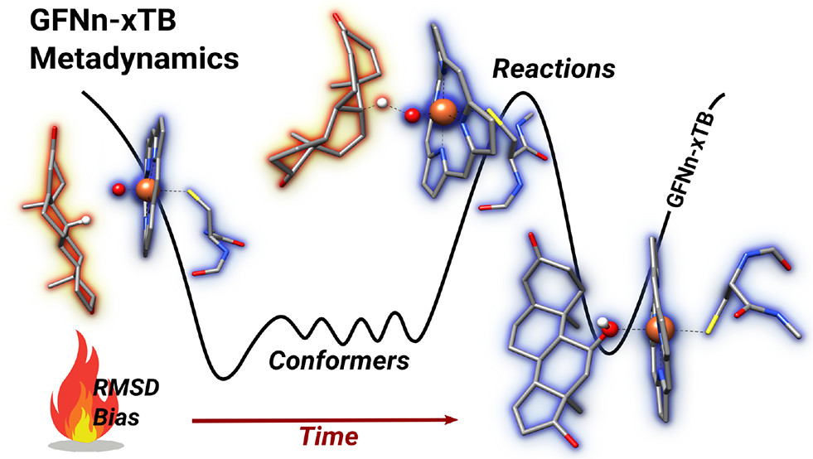


CREST and Conformational Searching
CAMLC 2025 Jaca, Spain
Heidi Klem – September 16, 2025
Louisiana State University
Baton Rouge, Louisiana
https://klem-research-group.github.io/

Slide 2

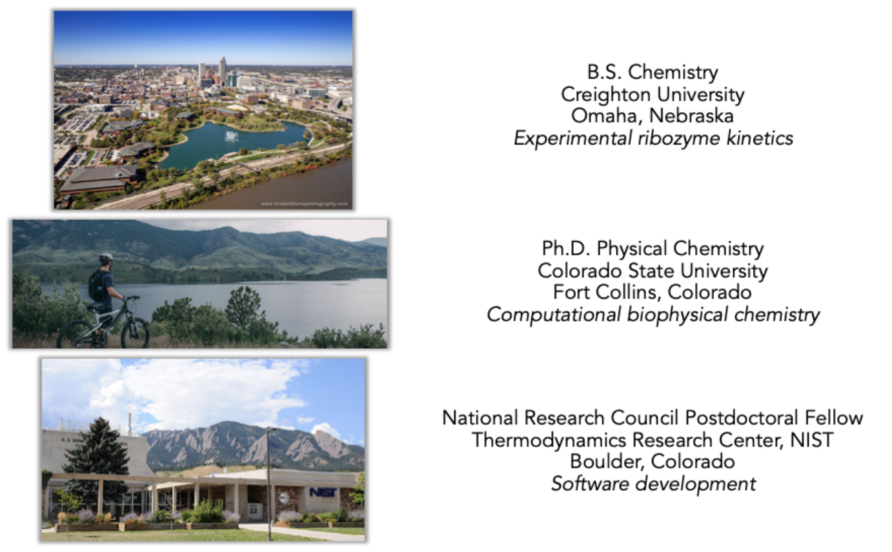
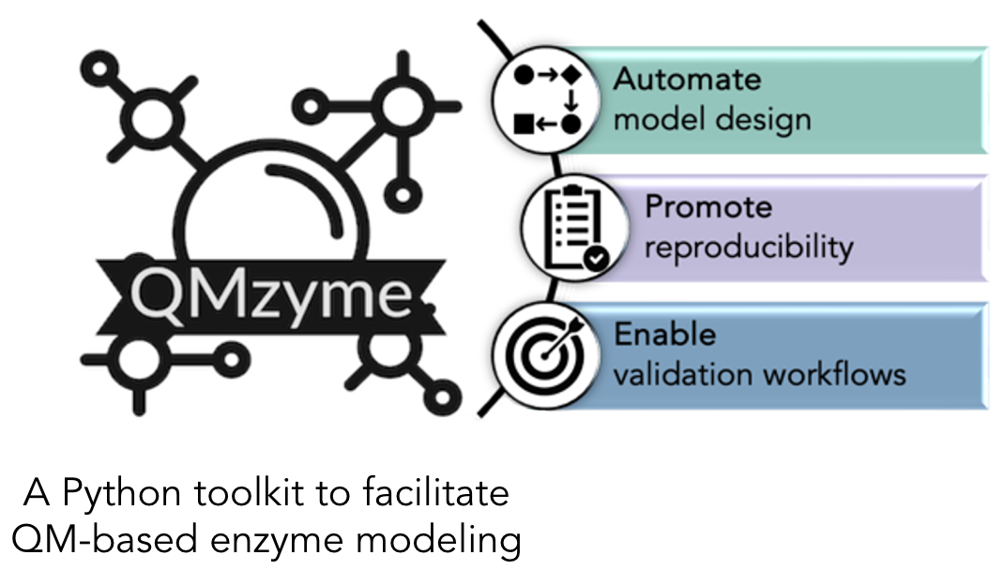
Background
Current
https://github.com/hklem/QMzyme

Slide 3
Download Files

Slide 4

How can we model chemistry consistent with experiment?

Slide 5
Core Computational Chemistry Methods
Molecular
Mechanics
Density Functional
Theory
Semiempirical
Ab Initio
Classical mechanics
Computationally inexpensive
Parameterized force fields
Based on Schrödinger equation
Parameterized with empirical data
Based on Schrödinger equation
Electron density rather than wavefunction
Quantum mechanics
Schrödinger equation
Approximations required
Nobel Prize in (computational) Chemistry
1998
John Pople “for his development of computational methods in quantum chemistry”
Walter Kohn “for his development of the density functional theory”
2013
Martin Karplus, Michael Levitt, and Arieh Warshel “for the development of multiscale models for complex chemical systems”
2024
David Baker ”for computational protein design”
Demis Hassabis and John Jumper “for protein structure prediction”

Slide 6
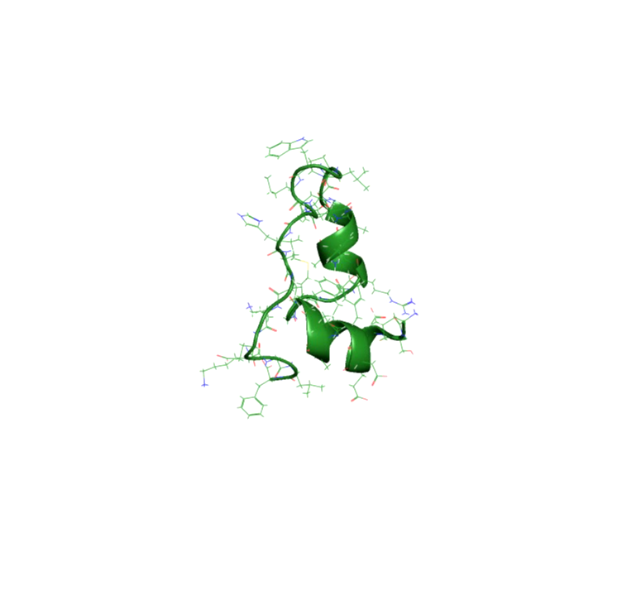
“Everything that living things do can be understood
in terms of the jiggling and wiggling of atoms”
- Richard Feynman
Snapshots from a 105 µs trajectory
Chicken villin heapiece-35 (HP35)
Simulation by D.E.Shaw Research
Notes:
Atoms are in perpetual motion (because absolute 0 in Kelvin is theoretical).

Slide 7
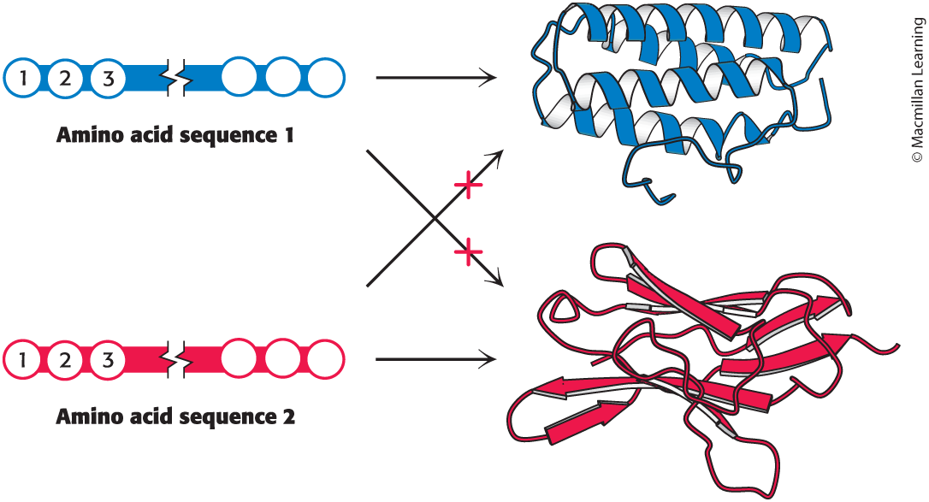
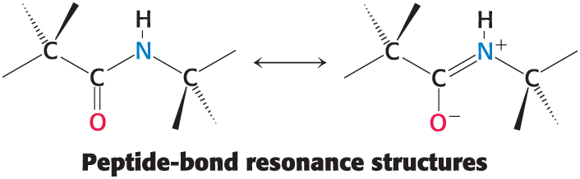
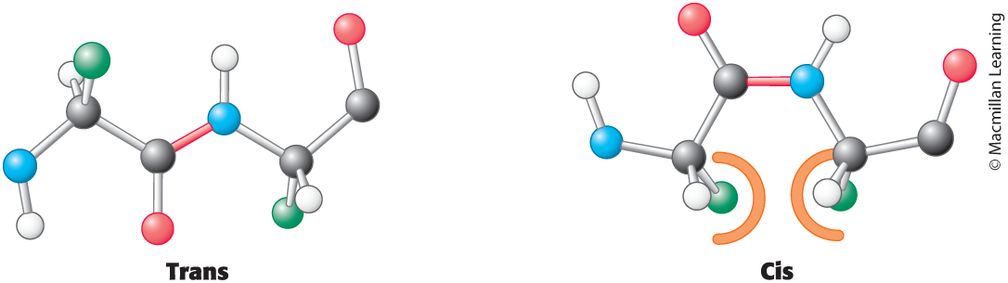
The Protein Folding Problem
Experimental determination can take 1+ year(s)
Levinthal’s paradox: estimated 10³⁰⁰ possible conformations
In nature, proteins fold within milliseconds
Energy landscape guides protein folding
Can we simplify the search
Primary
Tertiary
Notes:
Would take longer than the age of the universe to cycle through all possible conformations
Some chemical intuition simplifies the conformational space of polypeptides: amide backbone is planar due to resonance, and trans conf is MUCH more favorable due to the dipole moment. (> 99% of amino acids in protein structures are in the trans conf.)

Slide 8
Example: Protein Folding Mechanism
Structural clustering can be used to identify and quantify stable conformations
The resulting discretized trajectory data can be used with Markov State Modeling to recover the equilibrium properties of a process.

Slide 9
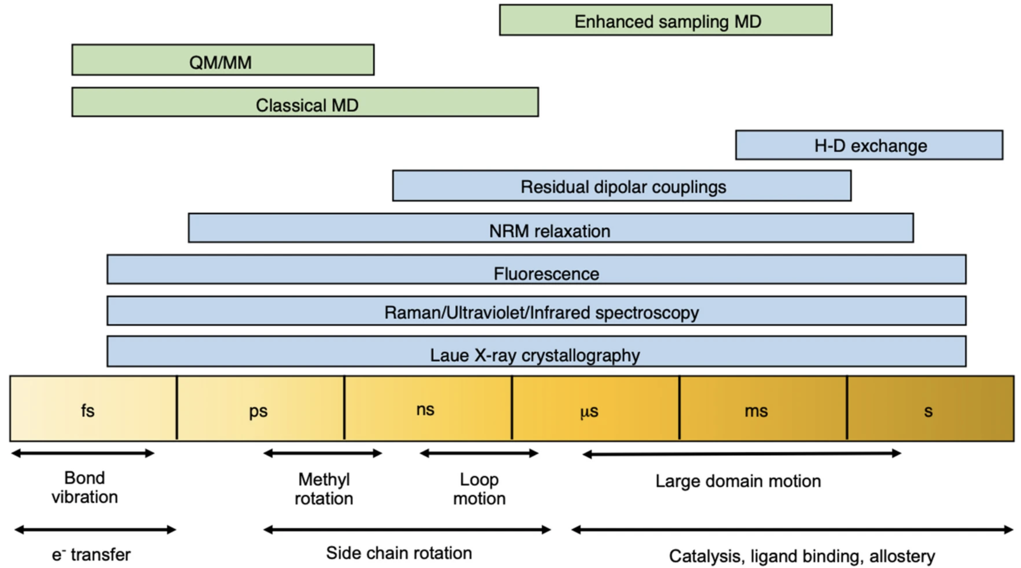
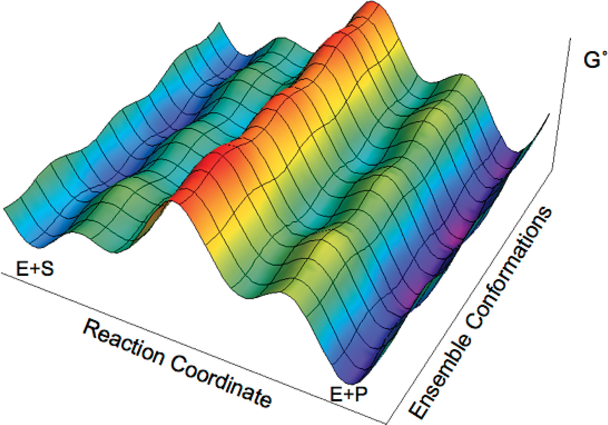
Molecular Motions in Folded Protein State
Multiple populations of conformations, intermediates, and transition states can exist.
Consider macroscopic/bulk
vs. microscopic
Notes:
Potential energy surface: describes the relationship between molecular geometry and energy
Conformational analysis is one of the central topics in computational chemistry.

Slide 10
How can we model chemistry consistent with experiment? How can we do this efficiently?

Slide 11
Conformational Search Approaches
Stochastic
Systematic
Molecular dynamics (time evolution of atomic positions) to explore conformational landscape
Goal is to sufficiently sample phase space to directly obtain the Boltzmann weighted conformational ensemble
Methods exist to expedite sampling
Represent geometric distributions that represent the experimentally relevant conformational ensemble
Applications to large molecules (well beyond 500 atoms)
Goal is to identify lowest energy conformers that represent the experimentally relevant conformational ensemble with automated heuristics
Better suited for small molecules ( < 100 atoms) often involving iterative procedures
Calculations performed on minimized conformers and results are Boltzmann averaged
Depending on the size of the molecule, it might be possible to figure out all possible conformers

Slide 12
Conformational Search
Can be computationally demanding depending on the accuracy you seek
Intelligently designed systems & workflows, often involving multiple optimization rounds, can reduce the computational demand
Automation can promote reproducibility and reduce headaches!
A VERY general workflow might look like:
1. Efficiently and broadly generate geometries (stochastic and or systematic)
2. Fast geometry optimization and rank resulting conformers
3. Remove duplicates, select subset and reoptimize to refine ranking

Slide 13
Gets-the-job-done optimization
GAFF
General AMBER force-field
Parameterized for small organic molecules
ANI-1
Accurate NeurAl network engine for Molecular Energies
Deep neural network train on QM DFT calcs
Applies only to HCNO atoms
GFN2-xTB
Geometries, Vibrational Frequencies, and Noncovalent interactions
eXtensions in the AO basis set using density functional Tight Binding methods (tight-binding DFT)
All elements up to Radon
GFN-FF
Generic polarizable force-field of the GFN family of methods
All elements up to Radon
g-xTB?!
https://chemrxiv.org/engage/chemrxiv/article-details/685434533ba0887c335fc974
Sprenger, K. G., Jaeger, V. W. & Pfaendtner, J. J. Phys. Chem. B 119, 5882–5895 (2015).
Smith, J. S., Isayev, O. & Roitberg, A. E. Chem. Sci. 8, 3192–3203 (2017).
Bannwarth, C., Ehlert, S. & Grimme, S. J. Chem. Theory Comput. 15, 1652–1671 (2019).
Spicher, S. & Grimme, S. Angew Chem Int Ed 59, 15665–15673 (2020).
Froitzheim T, Müller M, Hansen A, Grimme S. J. ChemRxiv. (2025).

Slide 14

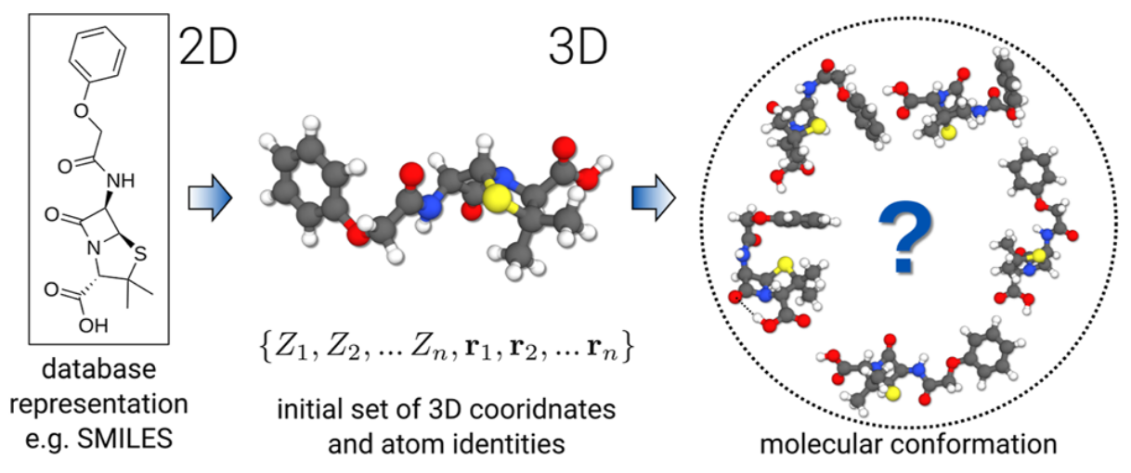
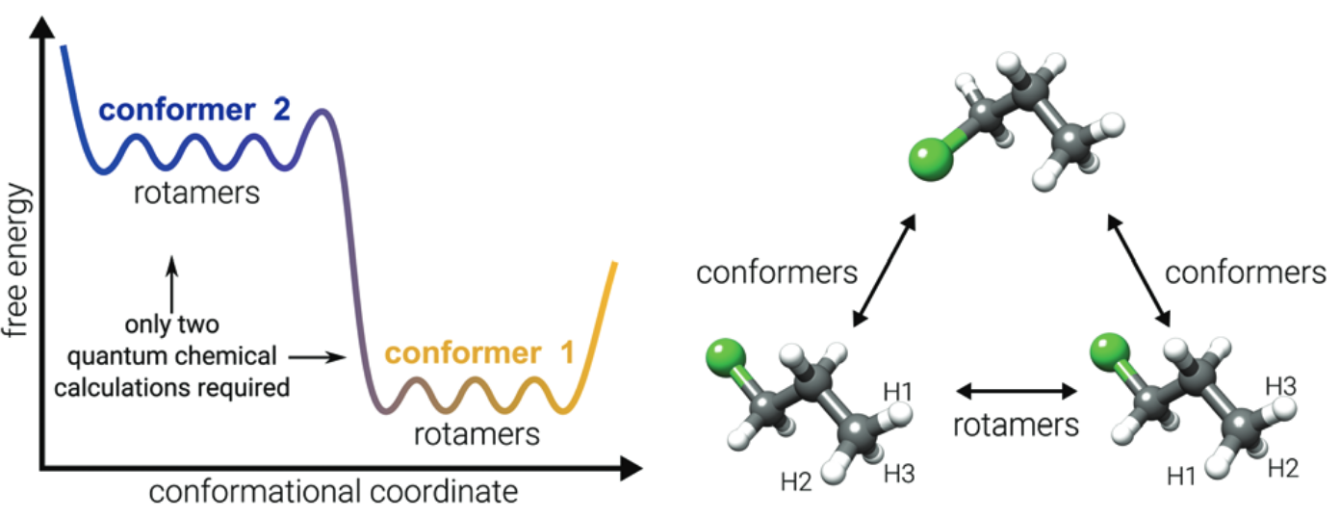
CREST
Conformer-Rotamer Ensemble Sampling Tool
For energy calculations and geometry optimizations, CREST uses either force field or semiempirical methods.

Slide 15
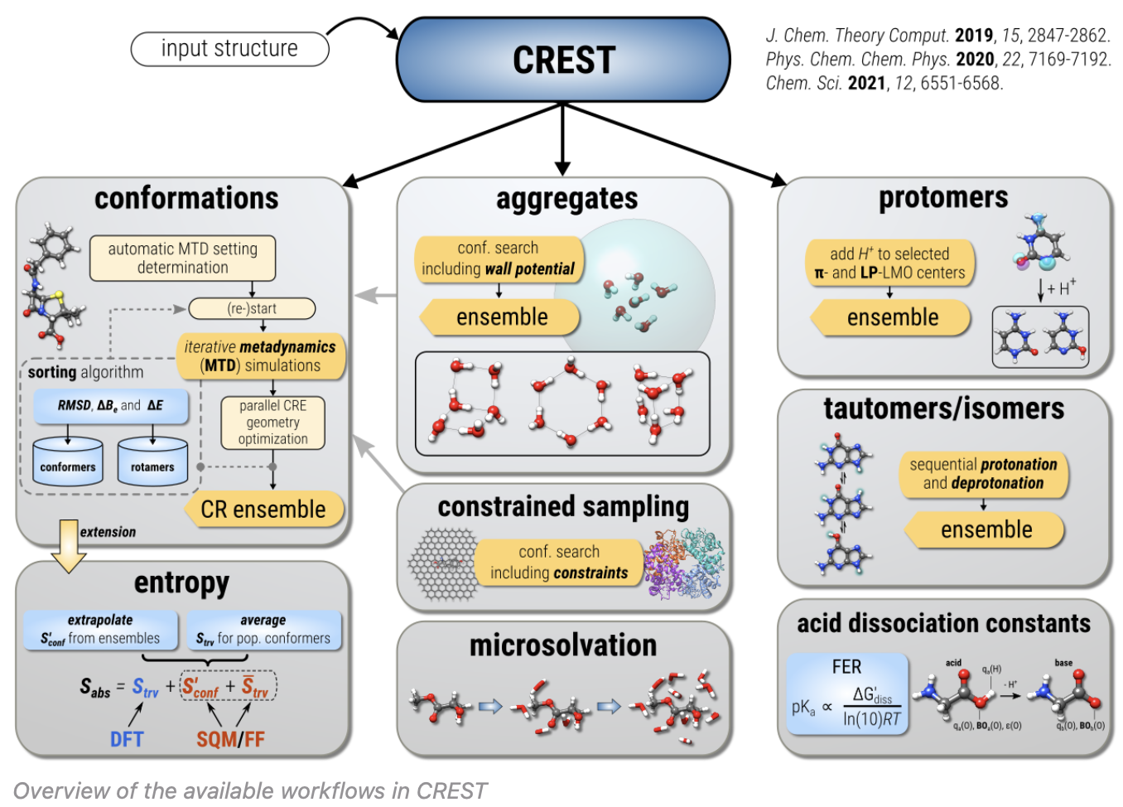
CREST ecosystem

Slide 16
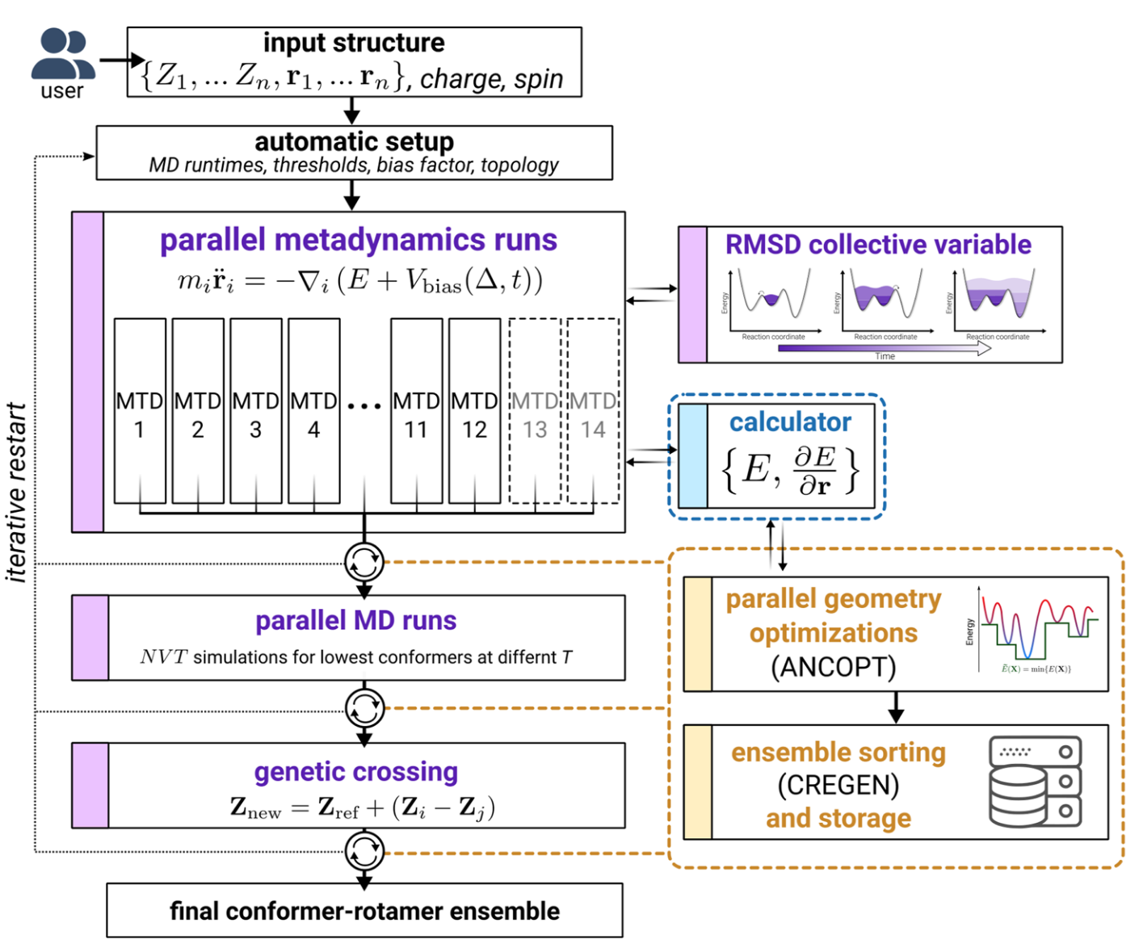
CREST iMTD-GC workflow
But first- let’s open up a Jupyter Notebook and get a calculation running, then we will talk about the procedure as it runs.
Parallel runs to vary parameters in the bias potential
MTDs are well-suited to cross high-barriers, at the cost of missing some small-barrier changes
MD runs are performed at two different temperatures on usually the lowest 4 confs found so far, to target rotamer sampling
Rotamer sampling is augmented by use of a GC algorithm to introduce “mutations”
The confs generated at each stage are reoptimized using the Approximate Normal Coordinate OPTimizer (ANCOPT) algorithm and if at any point a new lowest energy conf is found the process is restarted.

Slide 17
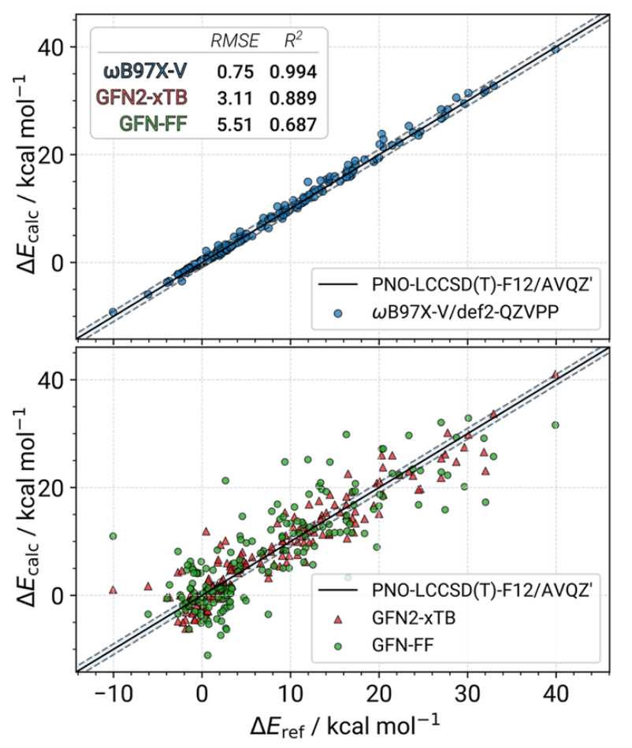
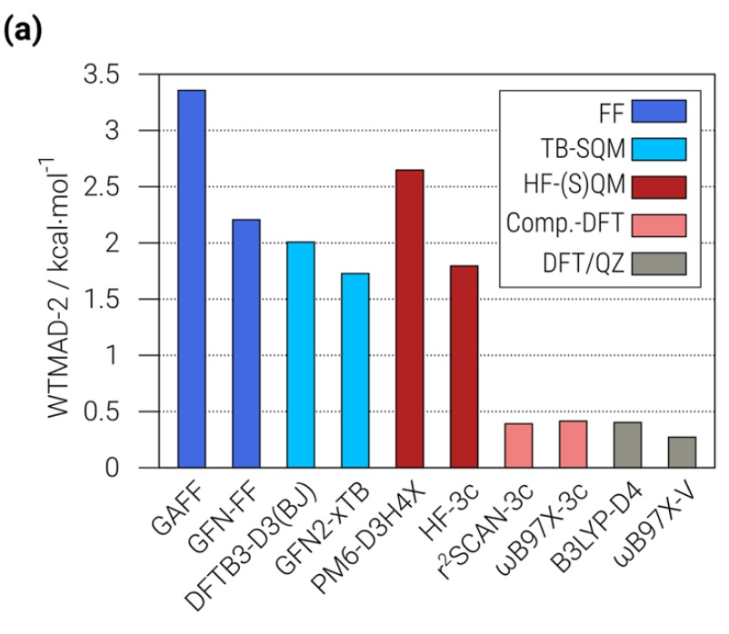
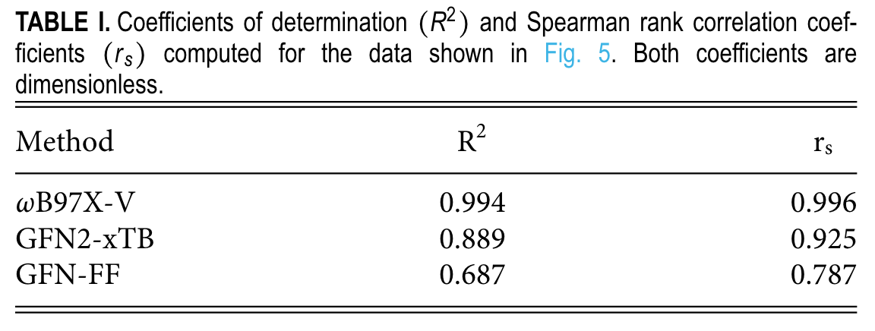
CREST benchmarking
GFN2-xTB
Conformational energies are more accurate than HF-S(QM), and less accurate than composite DFT methods
Much faster, and performs well in correctly ordering the conformers
Pracht, P. et al. CREST—A program for the exploration of low-energy molecular chemical space. The Journal of Chemical Physics 160, 114110 (2024).

Slide 18
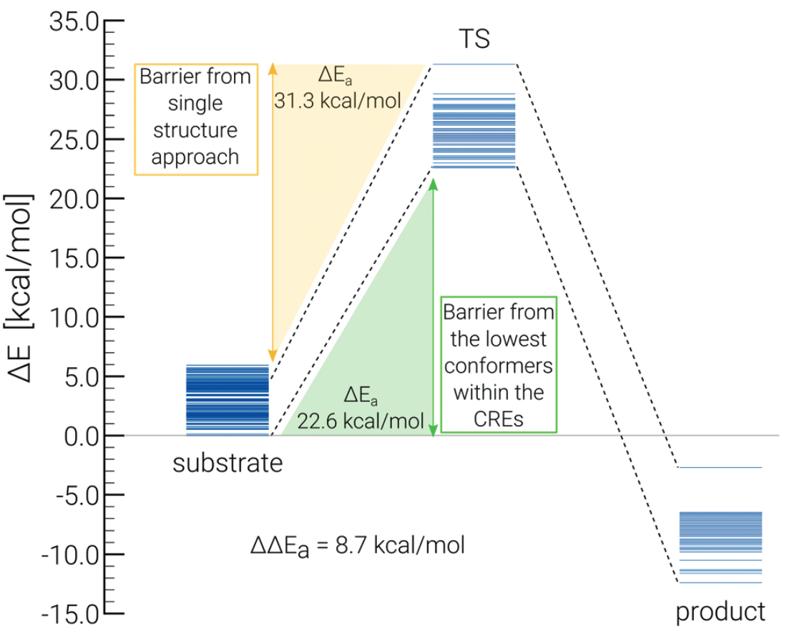
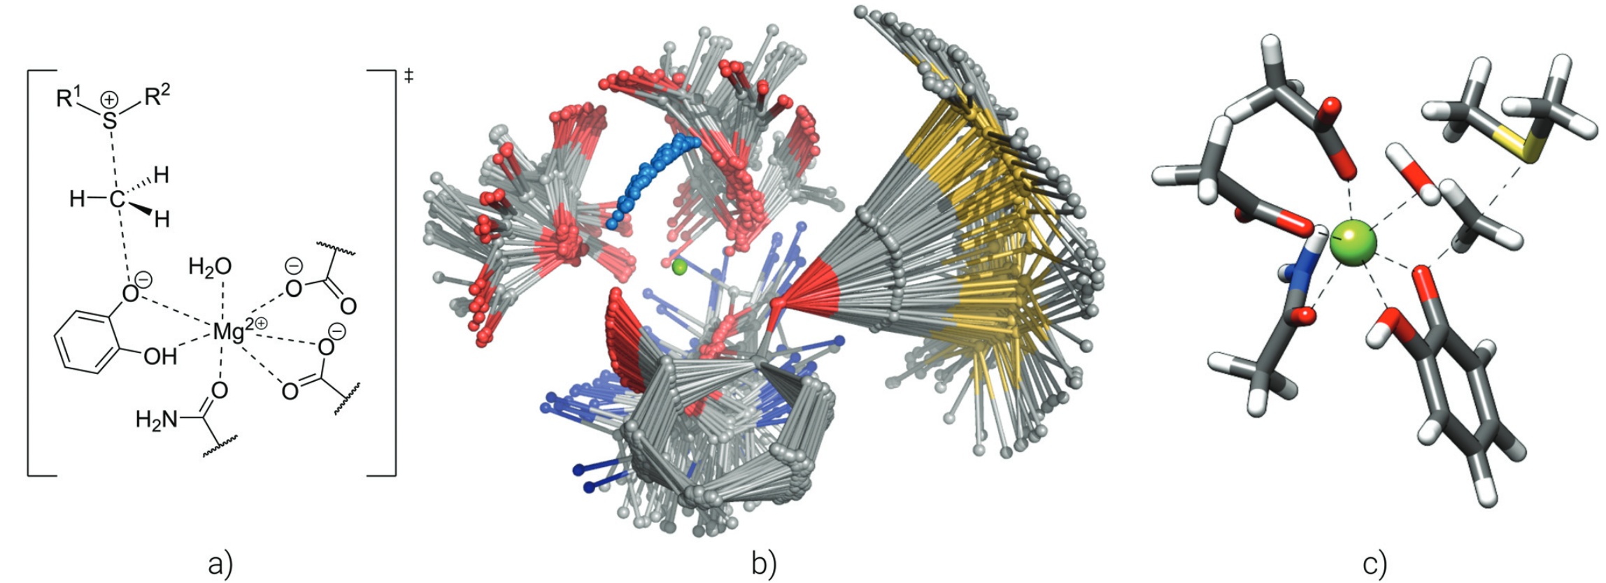
Constraints and non-covalent complexes
An ellipsoidal potential can be used to encapsulate the studied complex and avoid problems due to the metadynamics bias in non-covalent complexes
As opposed to previous program versions, CREST 3 implements the complete freezing of atoms in all metadynamics simulations and geometry optimizations
Pracht, P., Bohle, F. & Grimme, S. Automated exploration of the low-energy chemical space with fast quantum chemical methods. Physical Chemistry Chemical Physics 22, 7169–7192 (2020).

Slide 19
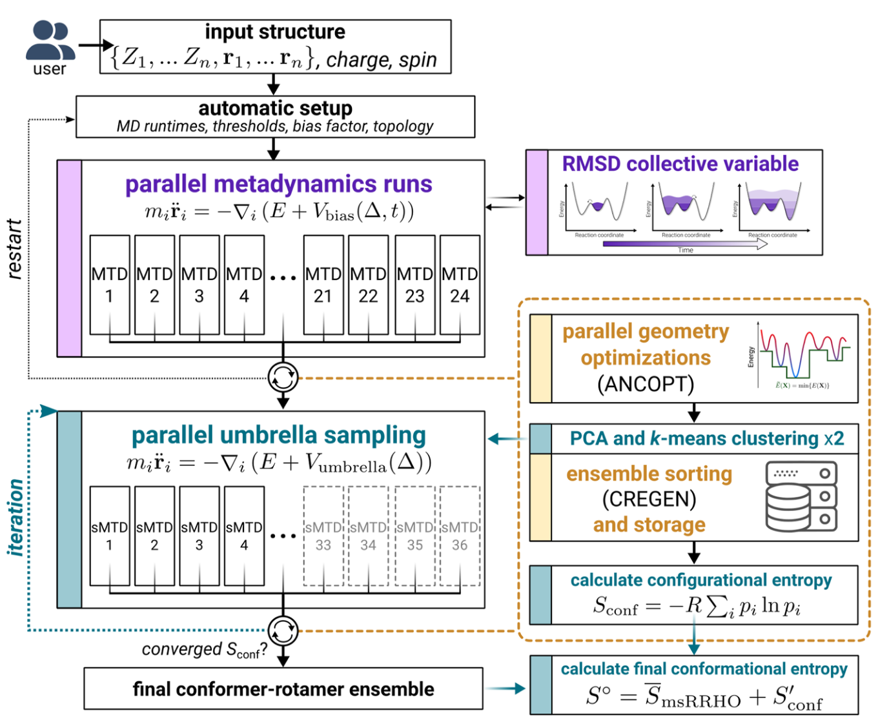
New and improved features in CREST 3.0
Iterative metadynamics–static metadynamics (iMTD-sMTD) workflow used to calculate the configurational entropy.
TOML based configuration files instead of just command line (significantly improves interoperability).
Stand alone single-point energy/gradient evaluation and geometry optimization available with --sp or --opt flag
QM/MM support
Can someone please write an entropy related script called entro.py?

Slide 20
Discussion points
Is the lowest energy conformer sufficient (what about kinetic trapping)? How can you support that? Experimental data is our friend, but remember what assumptions go into modeling.
What assumptions are being made? If you are truncating the system for ease of calculation, is the resulting conformational space adequately similar? Constraints!
Is your starting structure biasing the results?
Similar to transition state (TS) searches, conformational searches are an art. Creativity is your friend.
There is no one-size-fits-all solution, unfortunately.
CREST is broadly applicable: very approachable for new students, highly adaptable for more complex situations, interoperable/modular, open-source and going-strong, but it is not the complete solution!
Anyone have a fun/ugly/cool/ conformational analysis related research story to share?

Slide 21



Women Make COMP 2026 ACS Symposium Atlanta, Georgia
Presidential Recommended Event!
Abstract submission closes on September 29, 2025

Slide 22

Women Make COMP 2026 ACS Symposium
Confirmed Plenary Speakers
Jenny Chambers, Ph.D.
Senior Director of Education, Schrödinger
Shina Lynn Kamerlin, Ph.D.
Professor and Georgia Research Alliance Vasser Woolley Chair in Molecular Design, Georgia Institute of Technology
Christina Bergonzo, Ph.D.
Research Chemist, National Institute of Standards and Technology, U.S. Dept. of Commerce
AJ Lauer, Ed.D.
Founder, Thriving Ibis Leadership Solutions. Expert on diversity and leadership in computing. Author, ‘My Monster Mungo’

